Slide 1
5 Skills You Must Master to Excel (as a Developer)
Michael Eaton
Principal Consultant, Improving
Beer City Code, August 11, 2023

Slide 2
Who am I?
Husband
Father
Son
Caretaker of three cats
Developer with almost 30 years professional experience
Principal Consultant at Improving

Slide 3
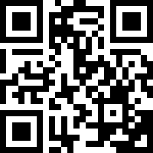
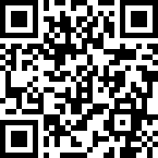
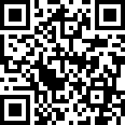
Improving
Improving is a modern digital services company that offers IT consulting, software development, and agile training across the globe. Our innovative solutions have helped thousands of our clients realize their tactical and strategic business objectives, allowing them to achieve great new heights in a competitive and ever-changing market.
Improving’s website https://improving.com
Improving Careers and Open Positions https://improving.com/careers
Improving Training and Upcoming Classes https://improving.com/services/training/

Slide 4
Goals of this session

Slide 5
Continuous Learning

Slide 6
Data Collection

Slide 7
Sharing Knowledge

Slide 8
Emotional Intelligence

Slide 9
Leading Up

Slide 10
Summary

Slide 11
Questions?

Slide 12
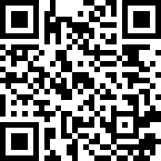
Contact Info
My personal website/blog with my contact information. https://samestuffdifferentday.com

